Slide 1
Lat/Lon Shapefile Creator
Alex Solorio

Slide 2


Project Idea
Program for converting text/CSV files into shapefiles
Similar to class exercise
Added features for increased functionality
Can handle different input types and produce different output types
Notes:
hi

Slide 3
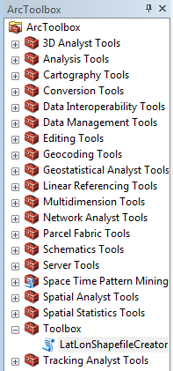
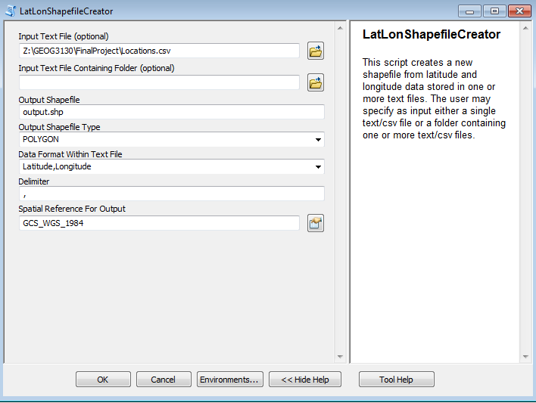
User Interface

Slide 4
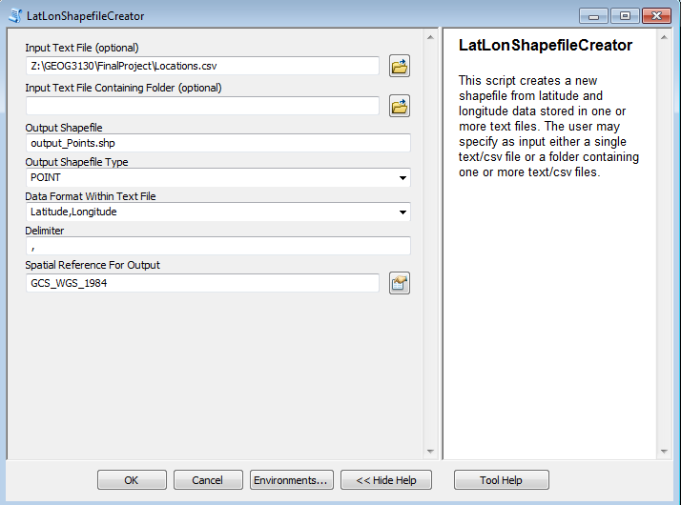
Example - Hurricane Path
Used the tool on the same dataset 3 times
Created 3 shapefiles
POINT
POLYLINE
POLYGON

Slide 5
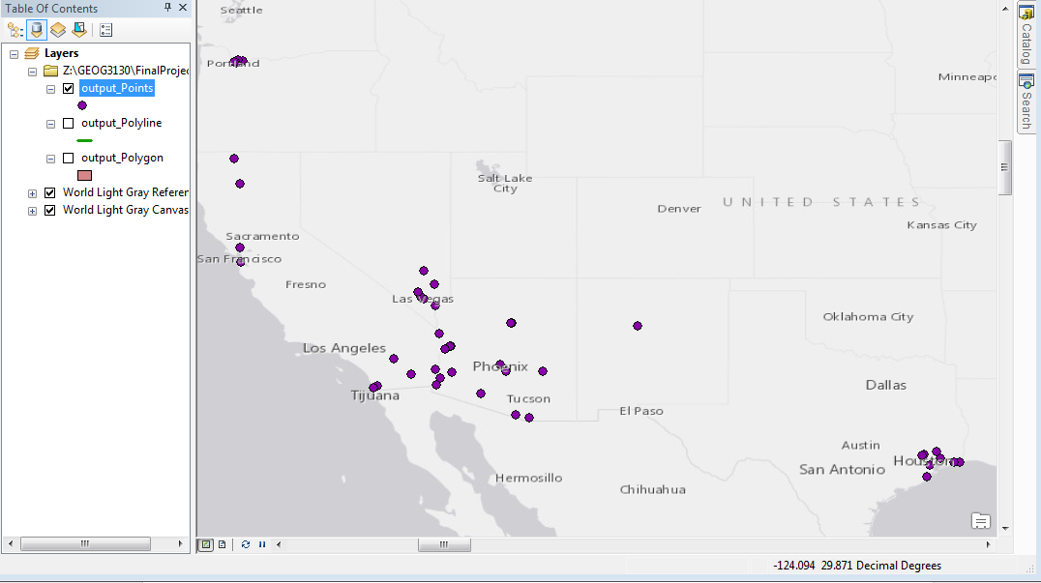
Example - Hurricane Path
Points

Slide 6
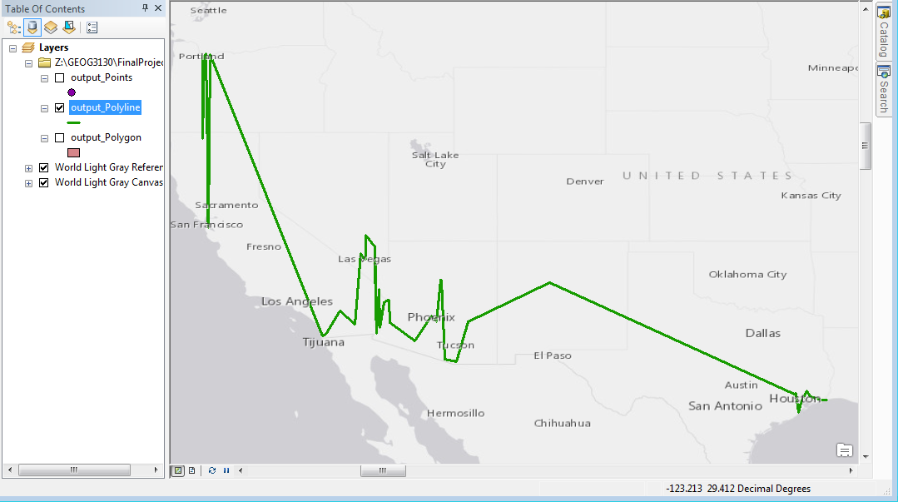
Example - Hurricane Path
Polyline

Slide 7
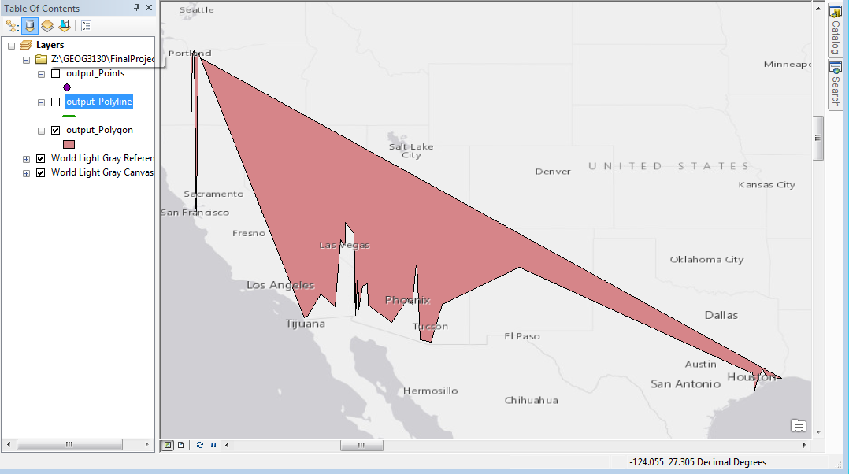
Example - Hurricane Path
Polygon

Slide 8
Future Goals
Further flexibility of input data types
Allow for fields other than lat/lon
Implemented with user inputting indices of lat/lon data within lines of CSV file
Ability to process different representations of latitude and longitude
40.7N ---> 40.7
40.7S ---> -40.7

Slide 9
Thanks!

Slide 10
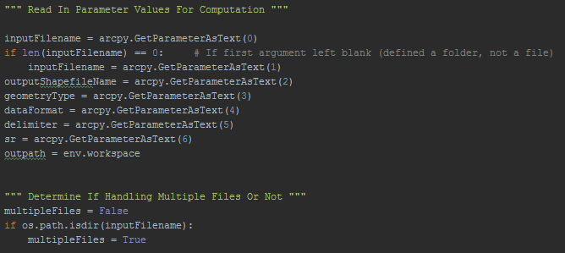
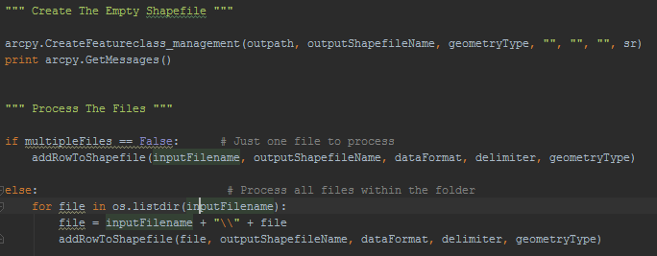
Python Code

Slide 11
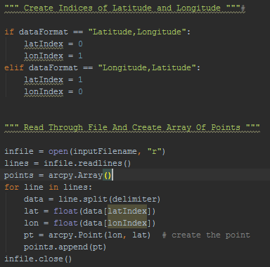
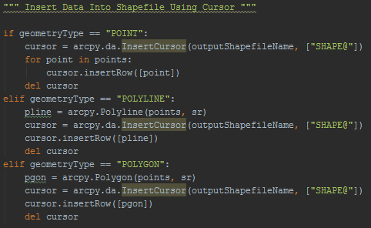
Python Code

